Slide 1


APBG
Missing data case study
Michael Fitzgerald
08-Dec-2023

Slide 2
Credits and Links
Tiffany Evans and Linda Wang - Help with the SAS programs and general sounding boards
DIA Missing data group (Particularly James Roger for sharing the MI macro and paper describing the theory)
LSHTM Missing data page
  https://www.lshtm.ac.uk/research/centres-projects-groups/missing-data#dia-missing-data
The code to recreate the case study
  https://github.com/mickfitz170186/SAS-Negative-binomial-clinical-trial-missing-data

Slide 3
Concepts
MCAR, MAR, MNAR
Implicit imputation
Single imputation
Multiple imputation
Tipping point analysis (2-way)
Notes:
Before we get into the case study, there are a few concepts that are important to know for this case study, I won’t be able to teach you them from first principles in this talk, we don’t have enough time, and Friday afternoon is not the best time for learning new things.
This will just be a quick refresh, and I’ll point out a few useful reminders that’ll help with understanding and interpretation of the case study that follows.

Slide 4
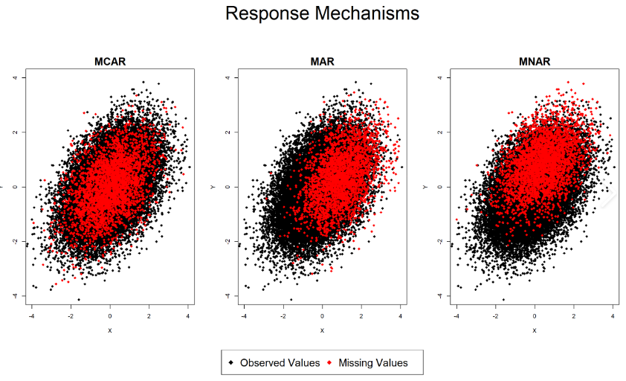
Concepts
Y
X
https://statisticsglobe.com/missing-data/
Notes:
Black is the observed data
Red is the missing data
We have the X and Y axes, so Y would be the outcome and X is a predictor or covariate.
Under MCAR, you can see that there’s no relationship between the missing data and either the outcome or the predictor. This is our ideal situation.
Under MAR, you can see that the missing data are shifted with the X axis variable, so the missing data are related to our covariate but not the outcome. This is ok, if we include the covariates/predictors in the model it’s taken care of.
Under MNAR, the missing data are related to both the X variable and the outcome on the Y axis.
It’s a problem because there is missing information, the missing data have a different relationship between the outcome and the predictor than the observed data. We not usually able to observe this, we can only speculate if it might occur and handle it accordingly.

Slide 5
Implicit imputation
This is where we use the data we have and a model to produce the statistics of interest. E.g.
  Mixed models
  Cox proportional hazards
  GEE’s
These examples operate under the MAR assumption
Notes:
With implicit imputation, we don’t impute any numbers at any stage. Our models assume that the missing data follow the pattern of data.
You are probably all familiar with implicit imputation methods e.g. …
These methods are often used for primary analyses and we should be aware of their MAR assumption

Slide 6
Single imputation
LOCF/ BOCF
Non-responder
Regression based methods (extrapolation)
Hot-deck selection
Mean/subgroup mean
Worst case
Notes:
These are methods where we substitute the missing value with a new value.
My hot take on single imputation methods, like LOCF, is that they are not inherently bad…
We should know that they come with their own assumptions or set of characteristics, and we should understand and acknowledge those characteristics when applying them.
I won’t got into it more here, there are some examples on the slide.

Slide 7
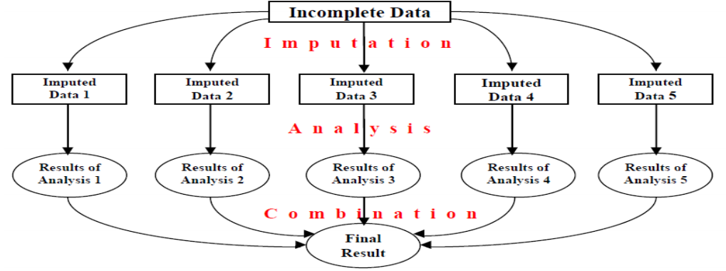
Multiple imputation
Using Rubin’s Rules
Notes:
Multiple imputation is a reasonably simple concept, the application can become very complex.
We take our incomplete data
Duplicate into many datasets with missing data
Use a method to explicitly impute each dataset, this is very broad and there are a range of documented techniques, the key is that the imputation technique maintains variability in the data.
Run the analysis on each set of imputed data
Combine the results using Rubin’s Rules. If you’re in SAS then this can be done with the PROC MIANALYZE procedure.

Slide 8
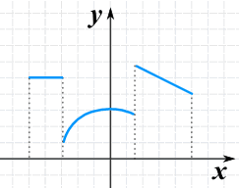
Pattern mixture models (PMMs)
Notes:
You might remember learning about piecewise equations or graphs in your studies, well PMMs are an extension of that.
In the context of imputation (usually MI), we can apply different models for different groups of data.
One of the things we can do at the imputation stage is decide to use different methods for different circumstances, e.g.
If someone has intermittent missing it’s common to use a MAR model to impute
If they drop out due to lack of efficacy we might use a different model, more like worse case.
If they drop out due to adverse events we might use another model again.
PMMs can help us model MNAR situations
They gives us great flexibility to follow the biology of the situation.

Slide 9
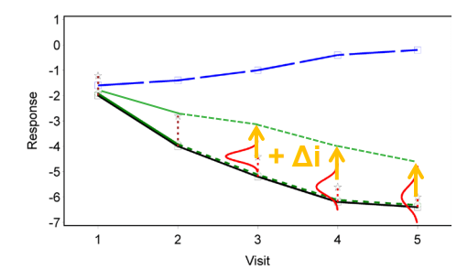
The delta method
p ≤ 0.05
p > 0.05
Notes:
Credit James Roger for this graph.
There are many types of PMMs we can use, but I’m going to focus on one I like.
The delta method is where we say someone with missing data performed like MAR but a bit worse.
We apply a delta to a parameter to make this happen.
How much worse? We can change the delta, we can have a few, with the max in the range being a biological extreme but plausible.
I like it because it let’s the end user/reviewer decide what is a reasonable penalty for potentially MNAR data.

Slide 10

Tipping-point analysis
Delta | 0 | 0.2 | 0.4 | 0.6 | 0.8 | 1.0 | 1.2 | 1.4
P-value | 0.001 | 0.020 | 0.035 | 0.045 | 0.060 | 0.085 | 0.150 | 0.200
p ≤ 0.05
p > 0.05
Notes:
If we do our analysis using a range of deltas for our MNAR imputation then we will sometimes find a point where the inference changes. This is our tipping point.
So, for this analysis, what is the tipping point?
If we use a range of delta’s we can see how extreme our MNAR assumption has to be before the inference changes, and so how robust our data/model are to MNAR data

Slide 11
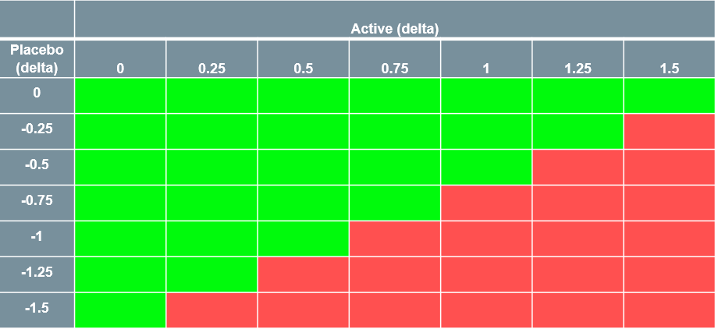
2-way tipping-point analysis
Easy, just vary the delta independently (and often in opposite directions) for the active and reference groups and observe what happens to our p-values
Notes:
Green cells represent statistically significant p-values, this could be <0.05 or something else if the endpoint is part of your multiple testing strategy.
Red cells represent p-values that are not statistically significant.
The black line is our tipping point.
A two-way tipping point is just where we vary the delta’s for the active and placebo groups independently, and usually in opposite directions. So, favourable for the placebo and penalizing for the active, just to keep things really conservative.
You can just do a one-way tipping point analysis, where you only vary the delta in the active and keep the placebo as zero delta. This would usually be sufficient.

Slide 12
Case study
Notes:
That’s the concepts explained, so let’s get into the case study to see how it could play out in reality.

Slide 13
Case study – Design and endpoint of interest
Phase III, multicentre, randomised, double-blind, placebo controlled clinical trial
Endpoint of interest – Count data over 52 weeks
Intercurrent events
  Premature end of treatment
Stratification factors
  Region (2 regions)
Notes:
This is a simplified study design to focus the case study on the interesting aspects.
… <read 2 points>
More events is a bad thing. Examples; hospitalisations, disease flare-ups, asthma attacks, use of rescue meds, … I’m sure there’s many more, this is a common type of endpoint.
Visits every 4 weeks
… <read point 3>
In reality, you can have many intercurrent events, and you could have different strategies for each of them.
… < read point 4>
We’ve just included a single stratification factor to simplify the case study while keeping important factors

Slide 14
Case study – Planned analysis
Primary analysis – Negative binomial model,
  Region and treatment as covariates,
  An offset using the natural log of time at risk is included
Sensitivity analysis 1 – Single imputation tipping-point
Sensitivity analysis 2 – Multiple imputation using MAR
Notes:
Primary – Note that the inclusion of the offset makes this an implicit imputation under the MAR assumption
Sensitivity analysis 1 – Single imputation tipping point where the event count after the intercurrent event occurs is imputed using the rate from primary analysis model + the planned delta.
Sensitivity analysis 2 –
The rationale for these analyses was, it’s done this way in a similar study 10 years ago…

Slide 15
Simulation
300 participants
Region (Bernoulli 0 – 75%, 1 – 25%)
Treatment (Bernoulli 0 – 50%, 1 – 50%)
Withdrawal (Bernoulli 0 – 90%, 1 – 10%)
Time
  When withdrawal=0 – 52
  When withdrawal=1 – uniform 1 – 51
Response (Negative binomial)
  When treatment=0 – p=0.7, k=1
  When treatment=1 – p=0.78, k=1
  If withdrawal=1 then pro-rata response count (round)
Notes:
We can’t use real data, partly confidentiality and partly that it’s not available yet.
So … we’re going to simulate something similar to what we’d expect in a real trial.

Slide 16
Results – Data checks
Intercurrent events
Treatment | Completer | Withdrawn
0 | 136 | 14
1 | 127 | 23
Events
Treatment | Mean (SD) | Median (min,max)
0 | 0.78 (1.25) | 0 (0, 4)
1 | 0.43 (0.78) | 0 (0, 3)

Slide 17
Results – Data checks
Event count for withdrawers
Treatment | 0 | 1 | 2 | 3 | 4
0 | 9 | 1 | 3 | 0 | 1
1 | 16 | 5 | 1 | 1 | 0

Slide 18
Results – Primary analysis
Negative binomial model
  Treatment and region as covariates
  Natural log of time as the offset
Treatment | Rate | 95%CI | Rate ratio | 95% CI | P-value
0 | 1.02 | 0.83, 1.26
1 | 0.68 | 0.53, 0.86 | 0.66 | 0.49, 0.90 | 0.0092
Notes:
Notes: Implicit imputation because of our offset for time
Assumption is that the rate after withdrawal is the same as the rate before.
Our p-value is significant (yay!)
The 95%CI width is 0.4, remember for later.

Slide 19
Results – Single imputation tipping point
A couple of interpretations:
1) Use the model-based rate to impute (within treatment and region) for the duration off treatment.
2) Use the individual level rate to impute for the duration off treatment.
Both methods add the delta to the rate
Notes:
This slide is a reminder to be specific and detailed in your SAP text.
In the real-life example this case study is loosely based on we had 2 statisticians interpret the SAP text differently.
<read text>
Our intention was the first and we had to update the SAP text to be clear, but …
We thought, that’s interesting, I wonder how it would affect the results? Let’s see.

Slide 20
Results – Single imputation tipping point (method 1)
 | Active (delta)
Placebo (delta) | 0 | 0.25 | 0.5 | 0.75 | 1 | 1.25 | 1.5
0 | 0.67 ( 0.39) | 0.68 ( 0.39) | 0.70 ( 0.40) | 0.72 ( 0.41) | 0.75 ( 0.42) | 0.78 ( 0.44) | 0.83 ( 0.46)
-0.25 | 0.67 ( 0.39) | 0.69 ( 0.40) | 0.70 ( 0.40) | 0.72 ( 0.41) | 0.75 ( 0.42) | 0.79 ( 0.44) | 0.84 ( 0.47)
-0.5 | 0.68 ( 0.40) | 0.69 ( 0.40) | 0.71 ( 0.41) | 0.73 ( 0.42) | 0.76 ( 0.43) | 0.80 ( 0.45) | 0.84 ( 0.47)
-0.75 | 0.68 ( 0.40) | 0.69 ( 0.41) | 0.71 ( 0.41) | 0.73 ( 0.42) | 0.76 ( 0.43) | 0.80 ( 0.45) | 0.85 ( 0.48)
-1 | 0.68 ( 0.41) | 0.70 ( 0.41) | 0.71 ( 0.42) | 0.74 ( 0.43) | 0.77 ( 0.44) | 0.80 ( 0.46) | 0.85 ( 0.48)
-1.25 | 0.69 ( 0.41) | 0.70 ( 0.41) | 0.72 ( 0.42) | 0.74 ( 0.43) | 0.77 ( 0.44) | 0.81 ( 0.46) | 0.86 ( 0.49)
-1.5 | 0.69 ( 0.41) | 0.70 ( 0.42) | 0.72 ( 0.42) | 0.74 ( 0.43) | 0.77 ( 0.44) | 0.81 ( 0.46) | 0.86 ( 0.49)
Cells contain rate ratio and 95% CI width
Cell colour: green when p<=0.05
red when p>0.05
Notes:
Notes:
0 – 0 cell has a very similar result to the primary analysis, this is validating since both are using the MAR assumption.
But the 95% CI width has reduced to 0.39, danger of single imputation
We can see the rate ratios decrease in magnitude as our deltas become more extreme
We see a small increase in the 95% CI with,

Slide 21
Results – Single imputation tipping point (method 2)
 | Active (delta)
Placebo (delta) | 0 | 0.25 | 0.5 | 0.75 | 1 | 1.25 | 1.5
0 | 0.64 ( 0.41) | 0.64 ( 0.41) | 0.65 ( 0.42) | 0.65 ( 0.42) | 0.66 ( 0.42) | 0.67 ( 0.43) | 0.68 ( 0.44)
-0.25 | 0.64 ( 0.41) | 0.65 ( 0.41) | 0.65 ( 0.42) | 0.66 ( 0.42) | 0.66 ( 0.42) | 0.67 ( 0.43) | 0.68 ( 0.44)
-0.5 | 0.65 ( 0.41) | 0.65 ( 0.42) | 0.65 ( 0.42) | 0.66 ( 0.42) | 0.66 ( 0.43) | 0.67 ( 0.43) | 0.68 ( 0.44)
-0.75 | 0.65 ( 0.41) | 0.65 ( 0.42) | 0.65 ( 0.42) | 0.66 ( 0.42) | 0.67 ( 0.43) | 0.67 ( 0.43) | 0.68 ( 0.44)
-1 | 0.65 ( 0.42) | 0.65 ( 0.42) | 0.66 ( 0.42) | 0.66 ( 0.42) | 0.67 ( 0.43) | 0.67 ( 0.43) | 0.68 ( 0.44)
-1.25 | 0.65 ( 0.42) | 0.65 ( 0.42) | 0.66 ( 0.42) | 0.66 ( 0.42) | 0.67 ( 0.43) | 0.67 ( 0.43) | 0.68 ( 0.44)
-1.5 | 0.65 ( 0.42) | 0.65 ( 0.42) | 0.66 ( 0.42) | 0.66 ( 0.42) | 0.67 ( 0.43) | 0.68 ( 0.43) | 0.69 ( 0.44)
Cells contain rate ratio and 95% CI width
Cell colour: green when p<=0.05
red when p>0.05
Notes:
Notes:
No tipping point is found.
This was odd, the reason is that our delta is a multiplicative effect, so remembering back to our high number of 0 counts in the withdrawn participants we have a clue.
0 multiplied by anything is 0 so we aren’t actually applying a delta to most participants.
For this reason, we strongly recommend avoiding this method.

Slide 22
Results – Multiple imputation - MAR
Primary analysis
Treatment | Rate | 95%CI | Rate ratio | 95% CI | P-value
0 | 1.02 | 0.83, 1.26
1 | 0.68 | 0.53, 0.86 | 0.66 | 0.49, 0.90 | 0.0092
MI - MAR
Treatment | Rate | 95%CI | Rate ratio | 95% CI | P-value
0 | 1.02 | 0.83, 1.26
1 | 0.68 | 0.53, 0.86 | 0.66 | 0.49, 0.90 | 0.0090
Notes:
Notes:
The only difference is the p-value, there are other differences down the decimal line, but at the level we’re interested in these analyses may as well be identical.
We should expect this because both methods are using the same assumption.
For this reason, I don’t really recommend MI with MAR for sensitivity analysis, mostly because it’s boring.
It can be of some value to validate your implicit imputation model.

Slide 23

Notes:
I think so:
The single imputation reduced the SE
The multiple imputation under MAR was a bit boring

Slide 24
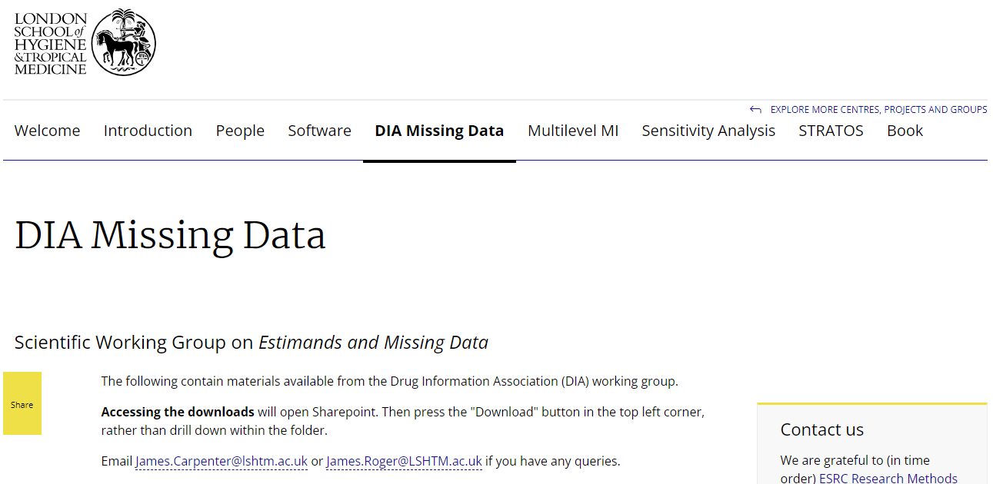
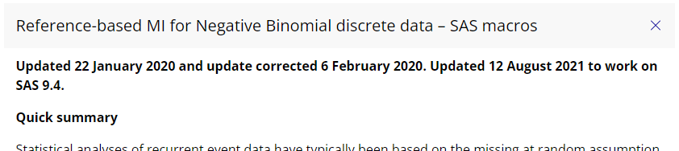
https://www.lshtm.ac.uk/research/centres-projects-groups/missing-data#dia-missing-data
Notes:
https://www.lshtm.ac.uk/research/ce
Big thanks to James Roger and everyone involved in the development of the methods stored here
The description and SAS macros used to get our results are all available and open source
Keene, O.N., Roger, J.H., Hartley, B.F., and Kenward, M.G. (2014). Missing data sensitivity analysis for recurrent event data using controlled imputation
ntres-projects-groups/missing-data#dia-missing-data

Slide 25
Multiple imputation – Tipping point analysis
How it works
  Run our model under MAR
  Use the BAYES statement in PROC GENMOD to output 100 sets of parameter estimates using MCMC
  Apply our delta to the effect size (or any MNAR adjustment)
  Impute missing data 100 times with the different parameter estimates
  Analyse our 100 new datasets individual
  Combine the results usings Rubin’s rules (PROC MIANALYZE)
Notes:
CR, J2R are both supported by the macros

Slide 26
Results - MI– Tipping point analysis
 | Active (delta)
Placebo (delta) | 0 | 0.25 | 0.5 | 0.75 | 1 | 1.25 | 1.5
0 | 0.67 ( 0.43) | 0.69 ( 0.43) | 0.70 ( 0.45) | 0.72 ( 0.46) | 0.75 ( 0.49) | 0.78 ( 0.53) | 0.84 ( 0.58)
-0.25 | 0.68 ( 0.43) | 0.69 ( 0.44) | 0.71 ( 0.45) | 0.73 ( 0.47) | 0.76 ( 0.49) | 0.79 ( 0.53) | 0.85 ( 0.58)
-0.5 | 0.68 ( 0.43) | 0.70 ( 0.44) | 0.71 ( 0.45) | 0.74 ( 0.47) | 0.76 ( 0.50) | 0.80 ( 0.54) | 0.85 ( 0.59)
-0.75 | 0.69 ( 0.44) | 0.70 ( 0.44) | 0.72 ( 0.46) | 0.74 ( 0.47) | 0.77 ( 0.50) | 0.80 ( 0.54) | 0.86 ( 0.59)
-1 | 0.69 ( 0.44) | 0.70 ( 0.45) | 0.72 ( 0.46) | 0.74 ( 0.48) | 0.77 ( 0.50) | 0.80 ( 0.54) | 0.86 ( 0.59)
-1.25 | 0.69 ( 0.44) | 0.71 ( 0.45) | 0.72 ( 0.46) | 0.75 ( 0.48) | 0.77 ( 0.50) | 0.81 ( 0.54) | 0.86 ( 0.60)
-1.5 | 0.69 ( 0.44) | 0.71 ( 0.45) | 0.72 ( 0.46) | 0.75 ( 0.48) | 0.77 ( 0.51) | 0.81 ( 0.54) | 0.87 ( 0.60)
Notes:
The numbers presented here are the rate ratio and the 95%CI width (to show some info on variation).
Let’s take a moment to digest these results, then we’ll do some comparisons.
Any questions?

Slide 27
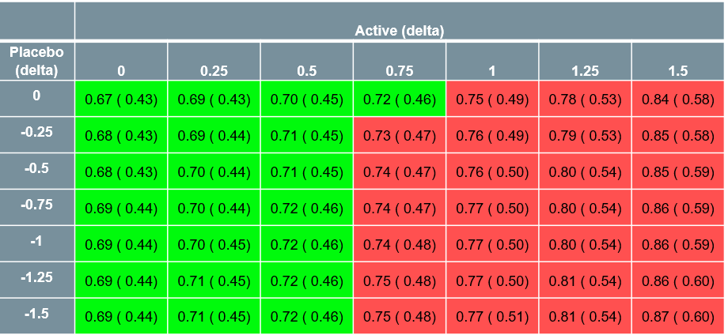
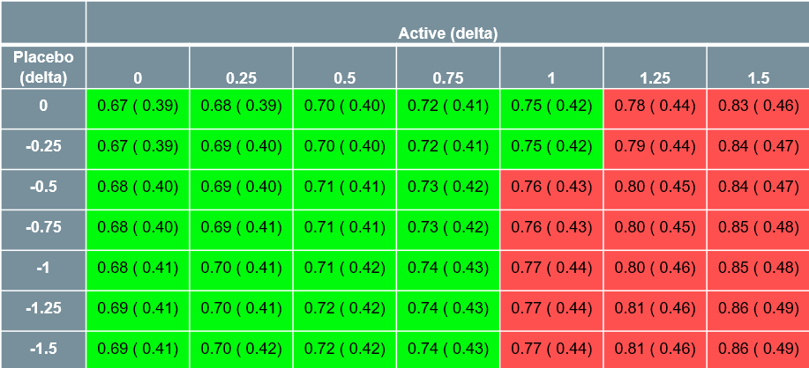
Multiple imputation
Single imputation
Notes:
Now we can see that SI and MI give very similar estimates, but the SE are smaller in the SI, this is a known problem with model-based SI methods, this simulation helps to prove and quantify it in a near real world situation.

Slide 28
Multiple imputation
Expected pattern
Notes:
Why don’t we get the expected tipping point pattern?
Imbalance in the amount of missing in each arm.

Slide 29

Thank you!
Reminder of those links and the key paper
LSHTM Missing data page
  https://www.lshtm.ac.uk/research/centres-projects-groups/missing-data#dia-missing-data
The code to recreate the case study
  https://github.com/mickfitz170186/SAS-Negative-binomial-clinical-trial-missing-data
Keene, O.N., Roger, J.H., Hartley, B.F., and Kenward, M.G. (2014). Missing data sensitivity analysis for recurrent event data using controlled imputation

Slide 30
Thank you

